Slide 1


ENSE 405 Project Check In #3
Youniversity: Software Design
February 22, 2021
Brandon Clarke, Brian(Jiwoun) Kim

Slide 2
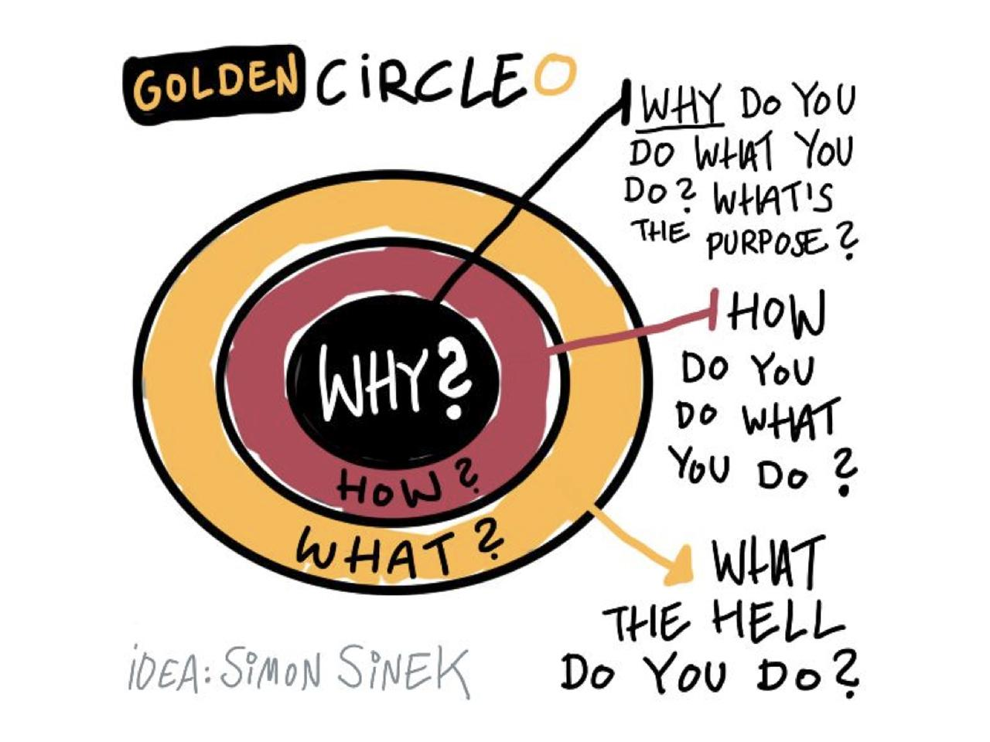
Why
Why don’t we have a tool for being exposed in
“qualified educational resources” on YouTube?
UN SD goal: 4.7 Quality Education. By 2030, ensure that all learners acquire the knowledge and skills needed to promote sustainable development, including, among others, through education for sustainable development and sustainable lifestyles, human rights, gender equality, promotion of a culture of peace and non-violence, global citizenship and appreciation of cultural diversity and of culture’s contribution to sustainable development (https://www.un.org/sustainabledevelopment/education/).
Notes:
The YouTube has updated so rapidly with huge amount of contents with variety of subjects therefore, helpful educational contents could be easily forgotten. Although Youtube has its own suggestion algorithms using AI, however it works for general results by using the user’s search and watch history. For those resources which can help to accomplish the education goal for the Sustainable Development, someone could help others with our software

Slide 3
How
By community members’ participation, the project would have been fulfilled the SD goal.
* It would be looking just like Twitter or Facebook, a kind of micro blogging service.

Slide 4
What
The project outcome would be building a tool that enables:
reviewing, sharing, recommending, and categorizing
[video tutorials] on Youtube.

Slide 5
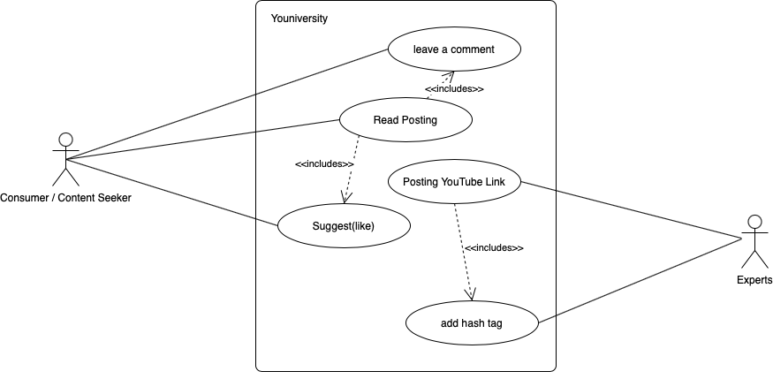
Architectural Diagrams / Use Case
Notes:
A consumer or content seeker reads a posting shared by an Expert. The consumer evaluates the content(YouTube video tutorial as a educational resource) and could contribute some effort by sharing a comment and/or a suggestion(pushing like button), so the other consumers could be inspired with the posting.

Slide 6
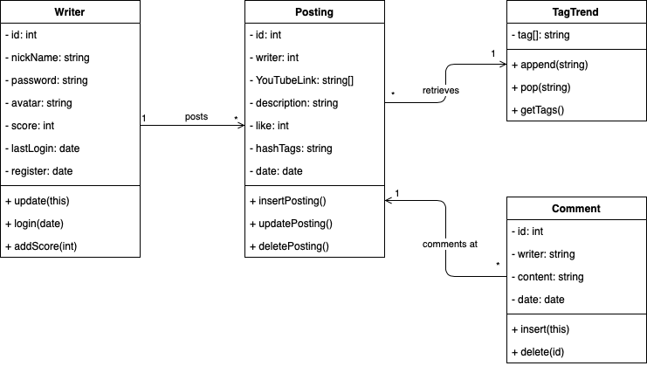
Architectural Diagrams / Class Diagram
Notes:
There are no member level for the writer, so anyone can share his or her good experiences with the tutorials or educational resources on YouTube. The posting can have multiple links of YouTube, comments and the hash tags. For the landing page, Tags are kept in a table as the top searched, clicked, or recent updated tags(keywords) in order to help out the consumers to reduce their overhead time searching the software.

Slide 7
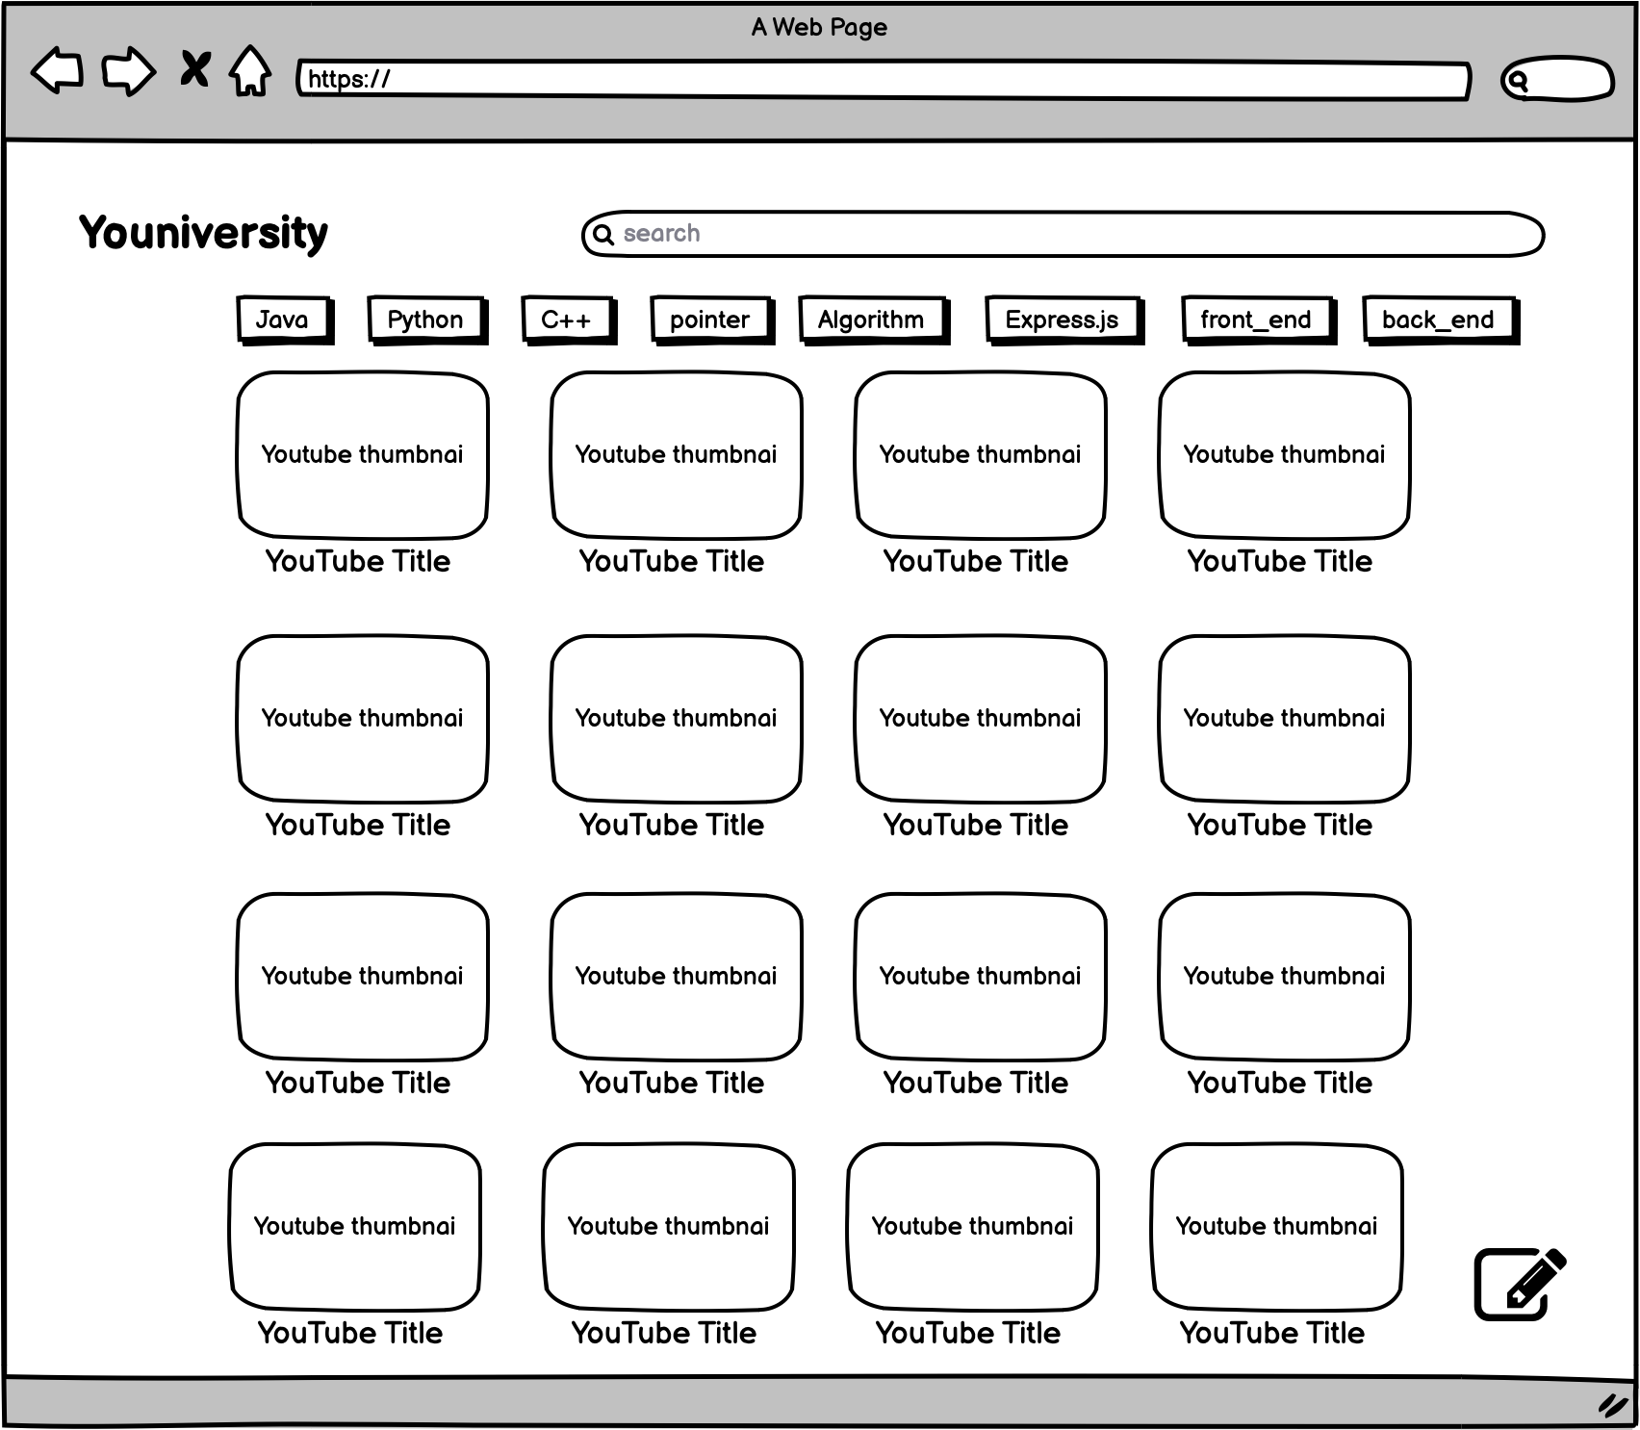
Prototypes - LoFi

Slide 8
Questions / Suggestions ?
1. Sustainable Development: https://www.un.org/sustainabledevelopment/wp-content/uploads/2020/05/SDG_website_E_v3_200px.png
2. Quality Education: https://www.un.org/sustainabledevelopment/wp-content/uploads/2019/07/E_Infographic_04.pdf
3. Golden Circle: https://4.bp.blogspot.com/-YLsIMp8vDV8/WohebVPrWwI/AAAAAAAAMPM/qdFHaYP_iJsc-i1427OT_jGcLI-kjY8MQCLcBGAs/s640/4b87188371db8a35398297fd593e8c31--business-inspiration-daily-inspiration.jpg
Image refs:

